Slide 1
Eurex EnLight
Quick Start Guide

Slide 2
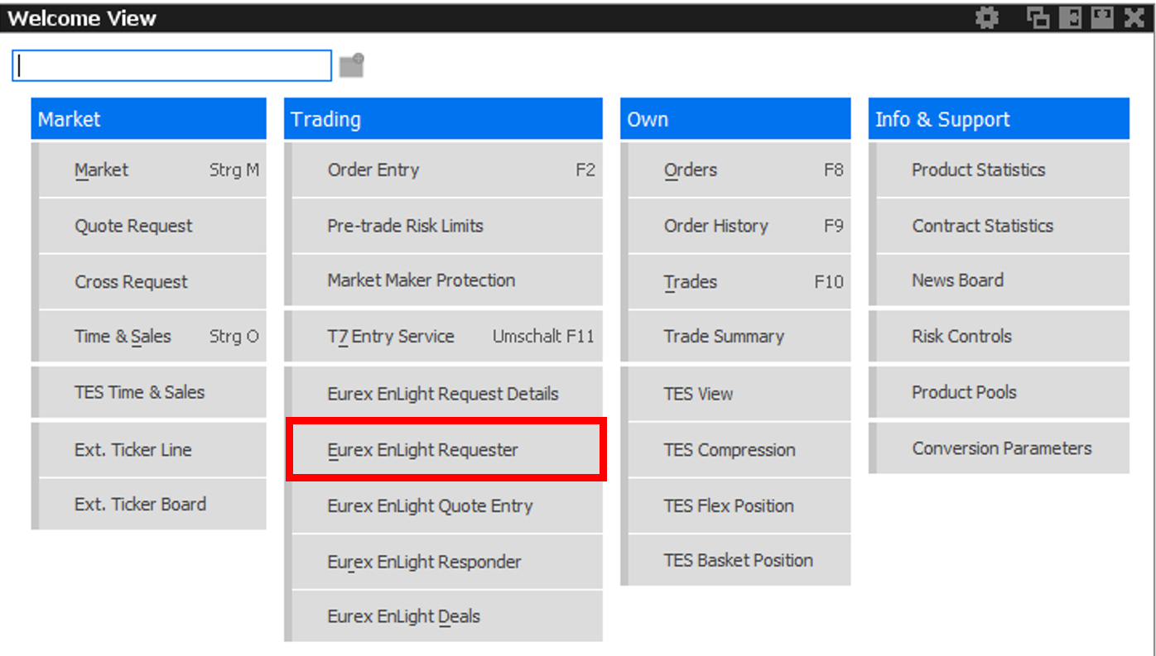
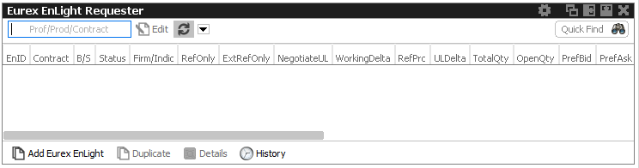
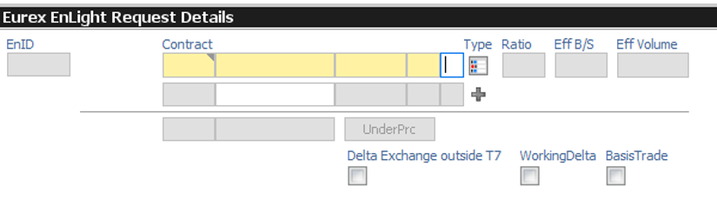
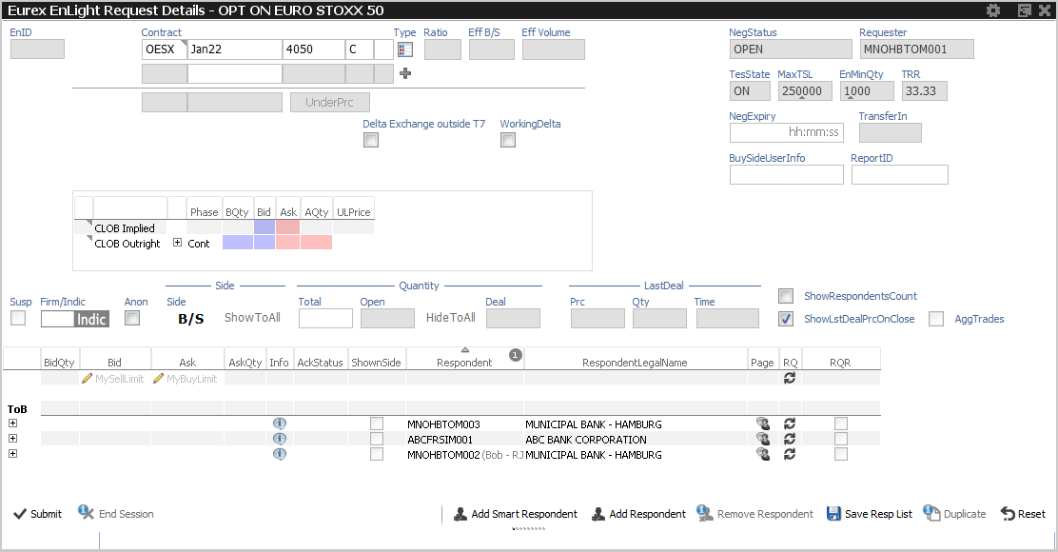
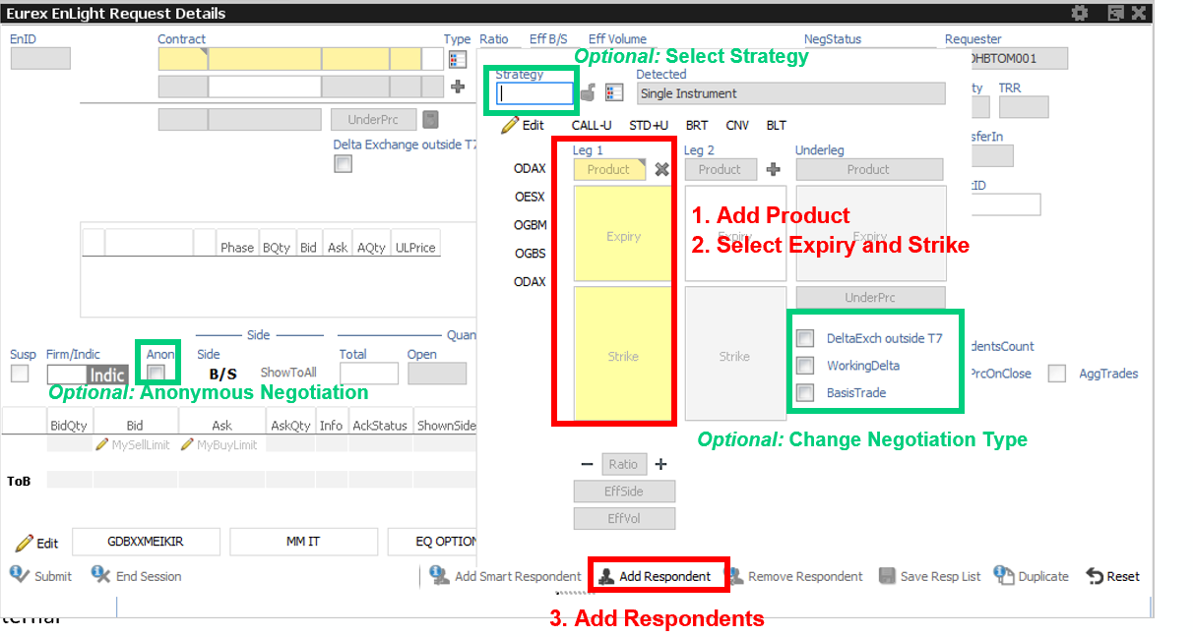
Eurex EnLight Submit RFQ Quick Start
Step 1: Select “Eurex EnLight Requester” on T7 User Interface
Step 2: On the Eurex EnLight Requester Blotter select “Add Eurex EnLight”
Step 3: On the Eurex EnLight Requester Details click on the Type Icon and strategy selection window will pop up
Step 5: Submit Request
Step 4: Fill in the RFQ Request

Slide 3
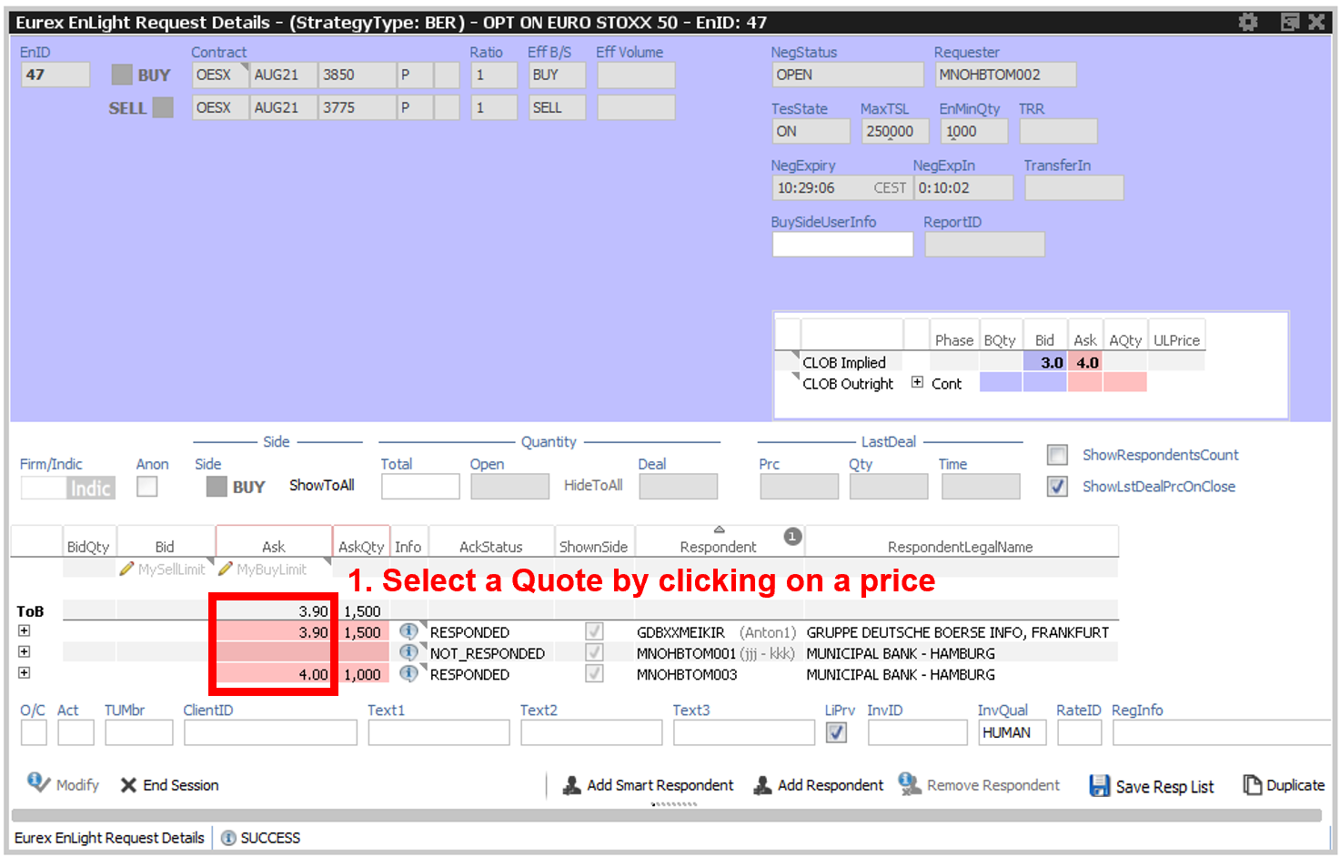
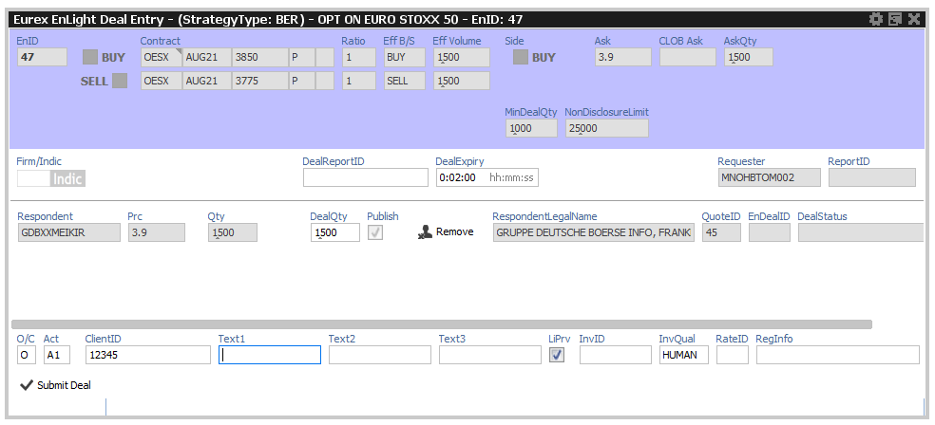
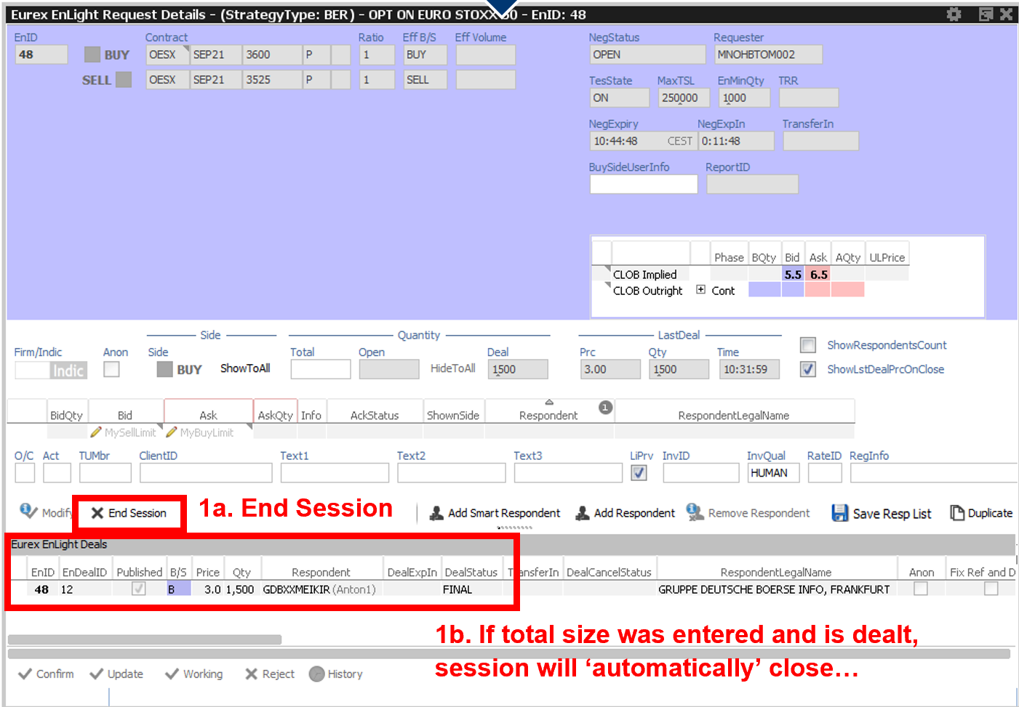
Eurex EnLight Dealing
Step 1: Select a Quote
Step 2: Review and Submit Deal
1. Review Deal
Deal entry window pops-up
2. Fill in MiFID fields (If they are not defaulted)
3. Submit Deal
After RFQ Session ends Transfer Timer starts
(No further user action required)
After Transfer Timer ends Trades are created at Eurex (No further user action required)

Slide 4
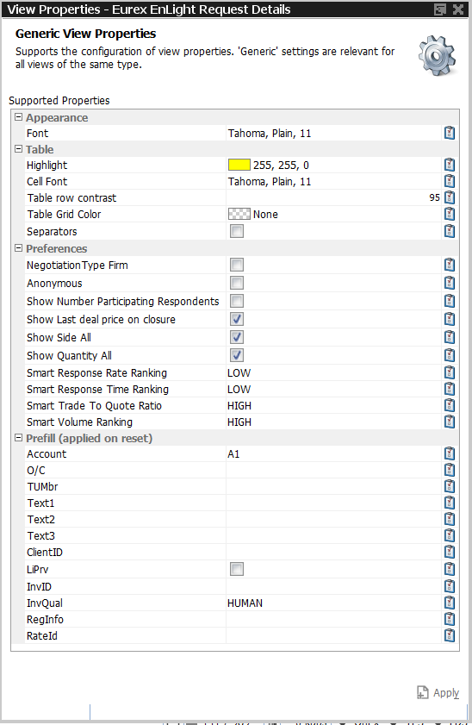
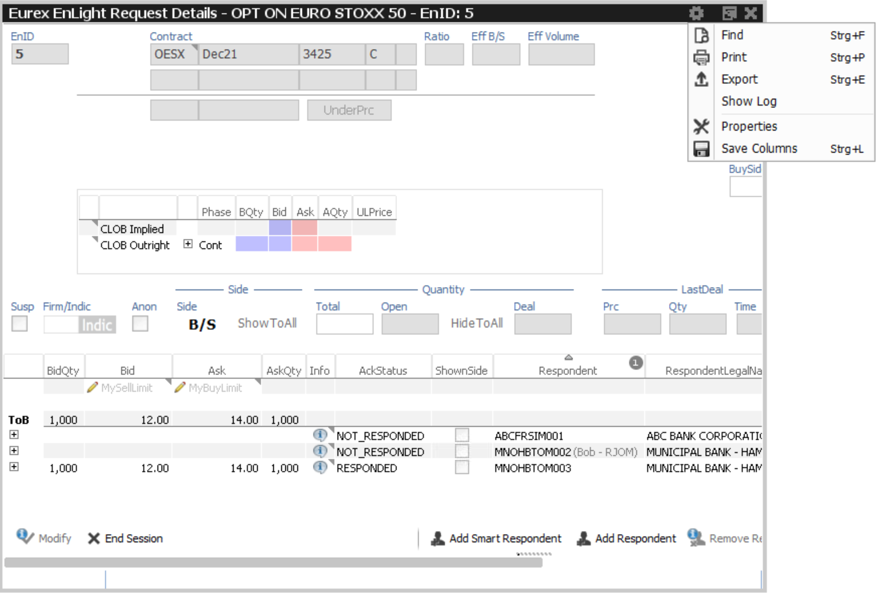
Eurex EnLight Requester Details Setting Defaults
Step 1: Click Settings Icon on the top right of the Request Window
and select “Properties” from the menu
Step 2: Set defaults for the MiFID fields and any other Request settings and Apply (You can override these on the ticket)

Slide 5
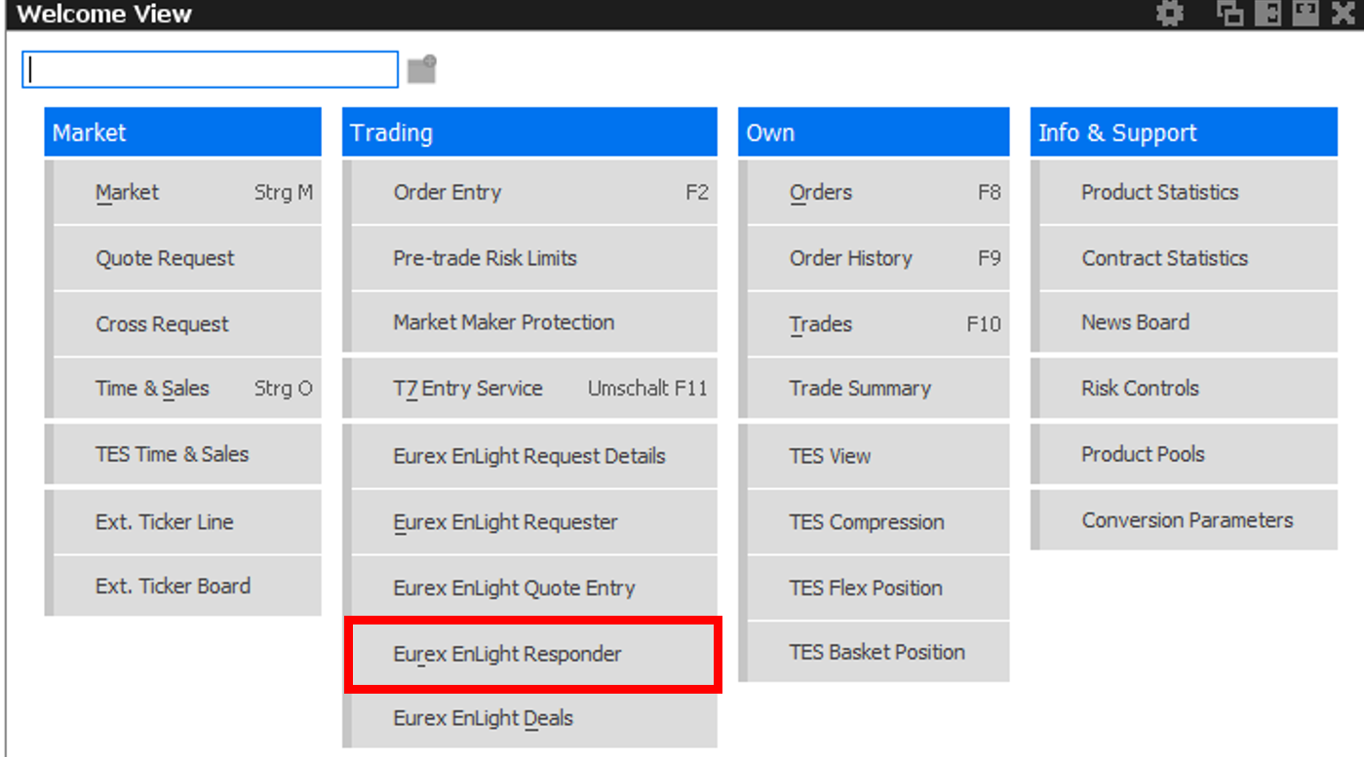
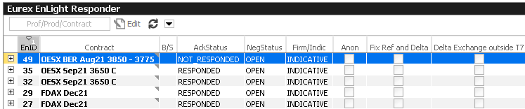
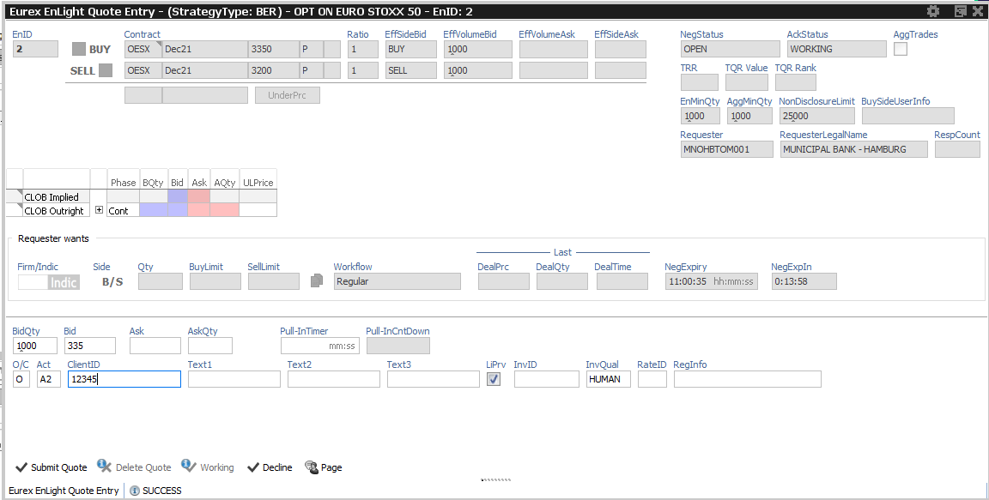
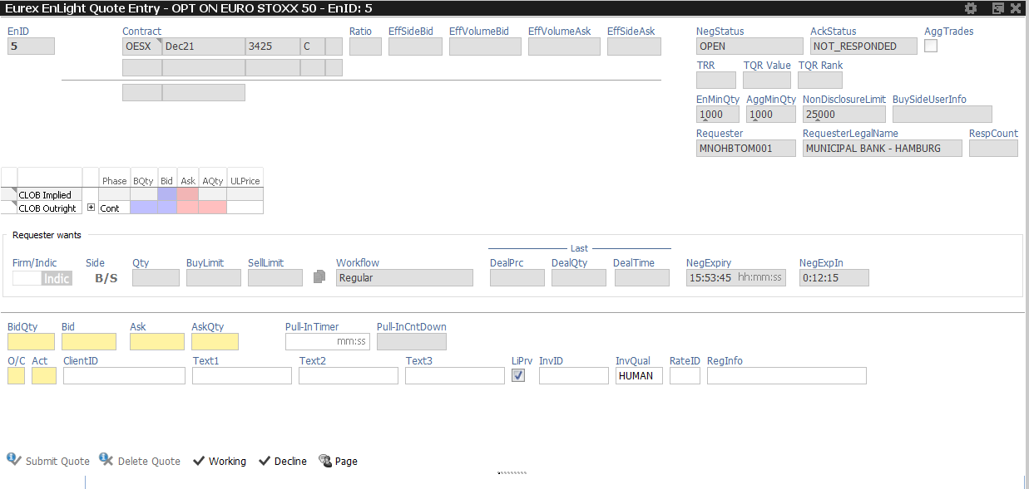
Eurex EnLight Responder Quick Start Guide
Step 1: Select “Eurex EnLight Responder” on T7 User Interface
Step 2: On the Eurex EnLight Responder Blotter double click the RFQ
you want to respond to
Step 3: Fill in your quote
1. Review
Strategy
2. Review information shared by the Requester (if any)
3. Fill in the mandatory fields for the Quote (in yellow)
4. Fill in the MiFID fields (Can be defaulted)

Slide 6
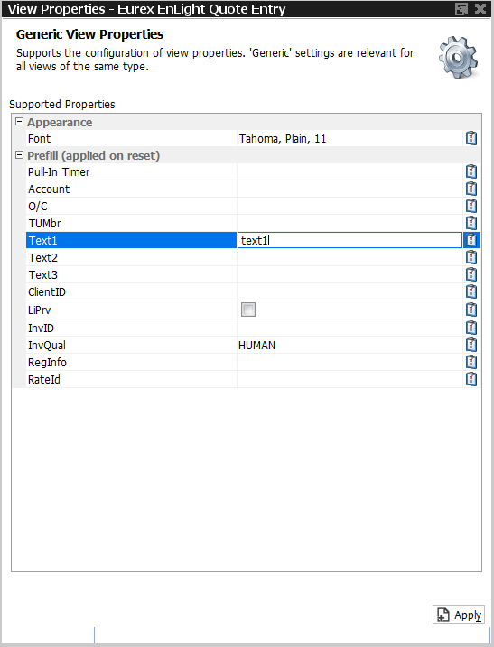
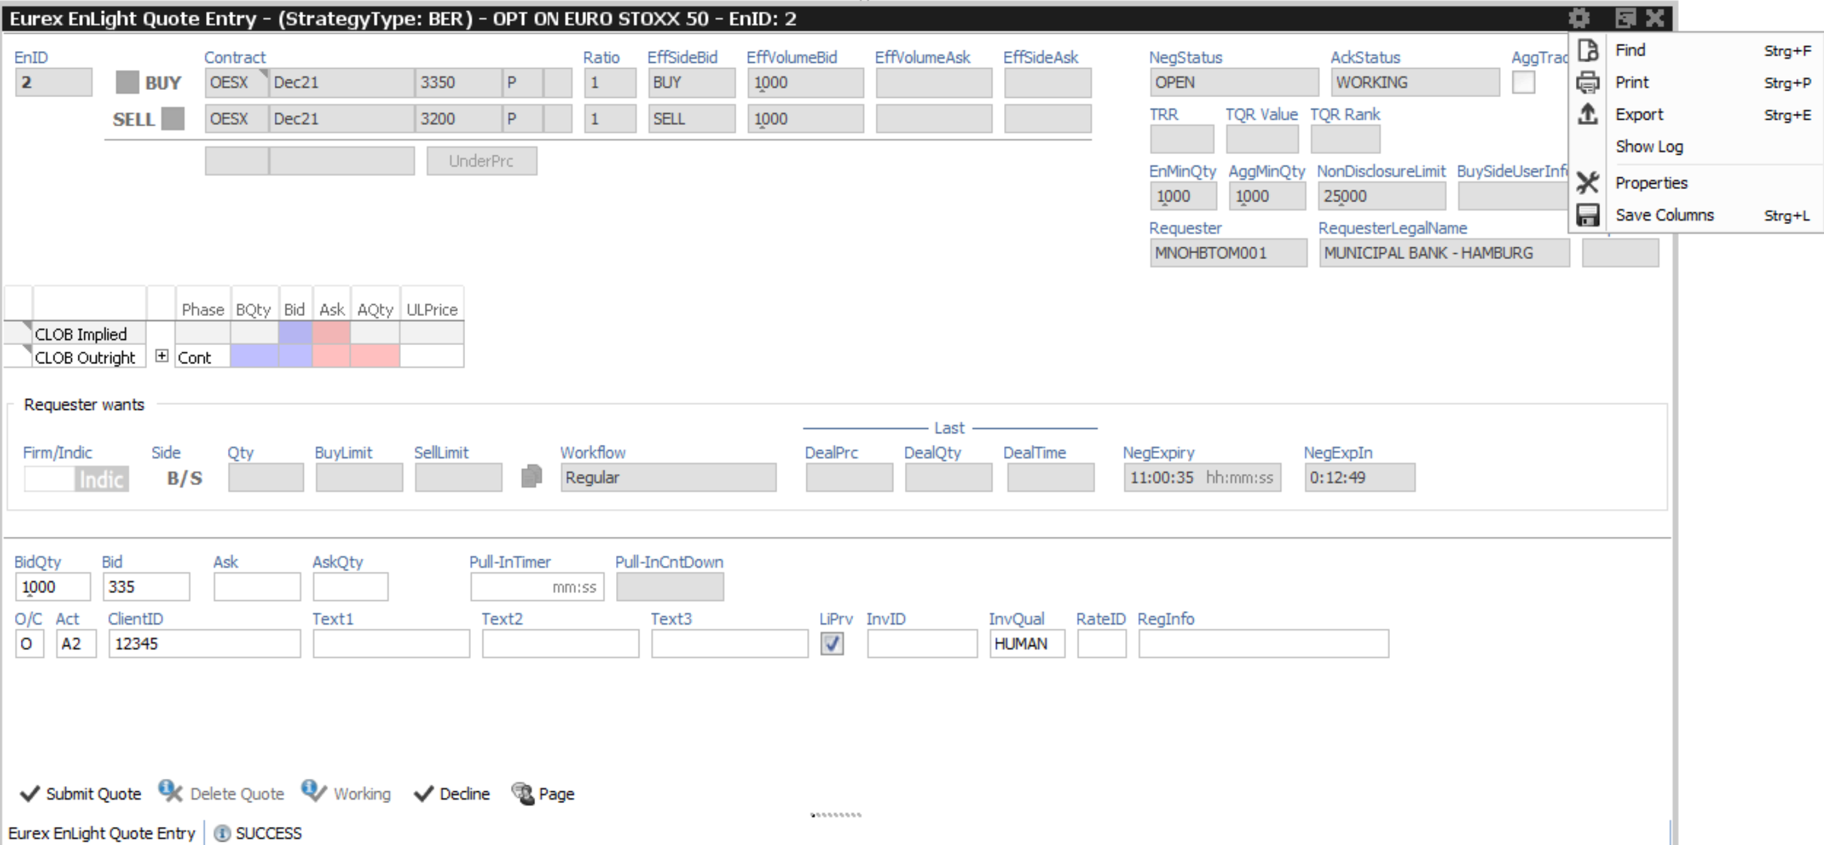
Eurex EnLight Quote Entry Setting Defaults
Step 1: Click Settings Icon on the top right of the Request Window
and select “Properties” from the menu
Step 2: Set defaults for MiFID fields and Apply
(You can override them on the ticket)

