Slide 1
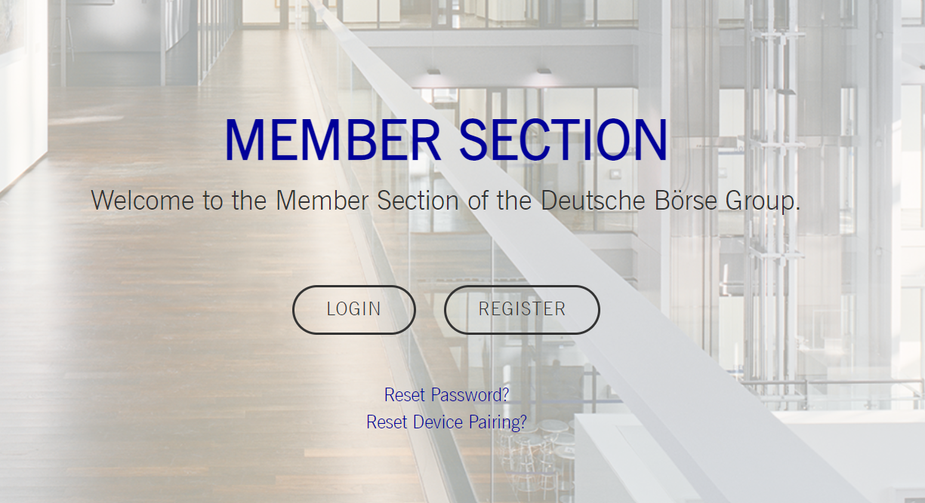
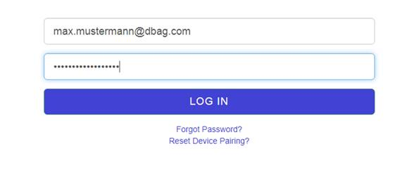
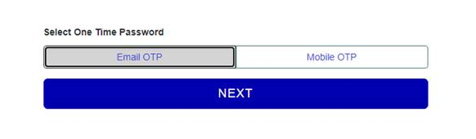
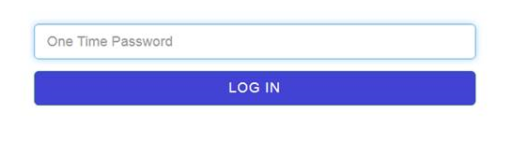
Deutsche Börse Group
Published: 2 February 2021
Version: 1.0
Member Section 2.0 - Quick account setup guide
Please follow these steps for a successful migration of your personal account for the Member Section 2.0.
1
Go to https://membersection.deutsche-boerse.com/
Click on „LOGIN“
2
Enter your user name (e-mail address) you have used so far to log-in to the Member Section in the field “User Name”
Click on “LOG IN”
3
Select if you want to receive your One Time Password (OTP, to verify your email address), via e-mail or to your mobile (please be aware this needs to be the number that is registered as part of your Member Section user account)
Click on “NEXT”
4
Check your e-mail account for an e-mail from “Member Section” (member.section@deutsche-boerse.com) with the subject “DBG One Time Password”
Open the e-mail, copy the number and enter it into the field “One Time Password”
Click on “LOG IN”
5
You are now successfully logged-in
Need further help or have any comments? Let us know:
member.section@deutsche-boerse.com

