Slide 1
Derivatives on MSCI ESG Screened Indexes
Launched on March 2, 2020

Slide 2
Eurex ESG Derivatives are leading the way by getting more traction from the buy-side
ESG Screened versions have gained more momentum thus far
Eurex is | #1 | by Open Interest in ESG Benchmark Derivatives Products |  | Traded volume YTD 2020: | 599,943 contracts ~ EUR 5.2 Billion
 | #1 | by Volume in ESG Benchmark Derivatives Products |  | Open Interest in end June 2020: | 48,094 contracts ~ EUR 636 Million
Open Interest Adjusted as of June 30, 2020

Slide 3
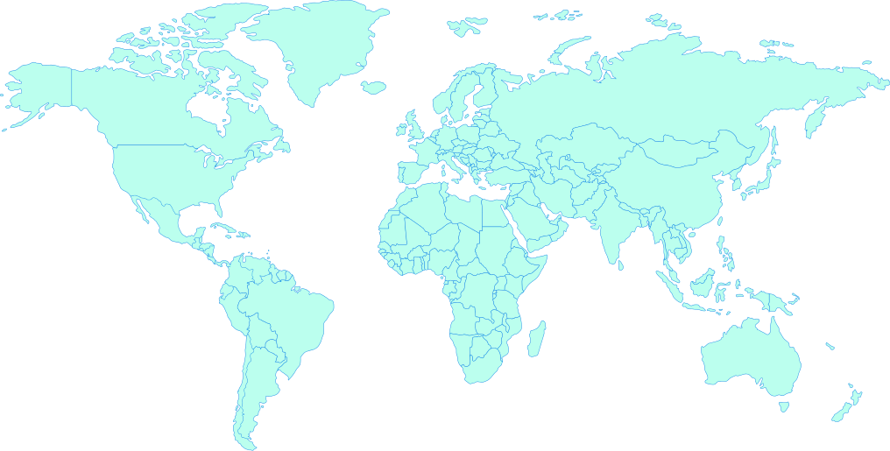
Eurex has strengthened its ESG offering by launching Derivatives on MSCI ESG Screened Indexes
MSCI ESG Screened Futures Products were launched on March 2, 2020
MSCI
USA ESG
Screened
MSCI
EAFE ESG
Screened
MSCI
Japan ESG
Screened
MSCI
World ESG
Screened
MSCI
EM ESG
Screened

Slide 4
MSCI ESG derivatives complement Eurex’s MSCI Derivatives flows
Eurex MSCI Derivatives are becoming an increasingly popular product
Eurex is | #1 | by Open Interest in MSCI Products (46% market share) |  | Traded volume YTD 2020: | 11,277,995 contracts |  | YoY Growth in MSCI Futures 2019 – 2020: | 13.32%
 | #3 | by Volume in MSCI Products (15% market share) |  | Open Interest in end June 2020: | 2.1 million contracts ~ EUR 81.9 billion |  | YoY Growth in MSCI Options 2019 – 2020: | 20.31%
Based on statistics from Jan 2020 – May 2020 Source: FIA
Open Interest Adjusted as of June 30, 2020

Slide 5
ESG Futures on MSCI World, EM and EAFE will compliment growth we have seen in these products
Performance of main benchmarks
All Open Interest values are depicted by number of contracts

Slide 6
MSCI ESG Screened Indexes are closest to benchmark (1/2)
Easy access to ESG compliance without compromising performance
Product Value
Key Values
  Flexible solution for asset managers with strict mandates to achieve ESG compliance
  Based on liquid and successful benchmark indices
  Similar risk and return figures compared to related benchmarks
  Simple and fast integration of the ESG Futures into the existing trading infrastructure
  Portfolio risk based margin (PRISMA) enables margin offsets
  Eurex ESG futures will lower carbon footprint
  Cost Efficient to incorporate ESG into investment strategies and manage undesired sustainability risks
  For the entire ESG offering, the index investment families are covering negative/exclusionary screening, norms-based screening, positive/best-in-class screening and sustainability themed investing
  Stepwise extension to complementary sustainability offerings, further regions and options
  Exclusions can help clients align their portfolios with: Social values; Financial, risk mitigation objectives; Regulations, global norms and treaties
ESG Screened
Easy to Implement
Easy to Access
General Facts

Slide 7
MSCI ESG Screened Indexes are closest to benchmark (2/2)
Easy access to ESG compliance without compromising performance
Why choose MSCI ESG Screened Indexes?
Aims to represent a broad universe of securities with limited exclusions
Provides investors with a transparent, consistent and more efficient option for those seeking to implement exclusions
The MSCI Screened Index leverages MSCI’s award-winning ESG Research expertise
The MSCI Screened Index can be used as a benchmark or as a basis for financial products
A market cap index with limited exclusions historically resulting in a minimal tracking error

Slide 8
Exclusion Criteria for MSCI ESG Screened Indexes
Selection of Exclusion
Thermal Coal
Companies deriving 5% or more revenue from mining or thermal coal or 5% or more revenue from thermal coal based power generation
Oil Sands
Companies deriving 5% or more revenue from oil sands extraction
E
ESG Exclusion Criteria
Tobacco
Companies classified as producers or deriving 5% or more aggregate revenue from production, distribution, retail and supply of tobacco-related products
Controversial weapons
Companies with ties to cluster bombs, landmines, depleted uranium weapons, chemical and
biological weapons, blinding laser weapons, non-detectable fragments, incendiary weapons
Civilian Firearms
Companies classified as producers of firearms and small arms ammunition for civilian market
or deriving 5% or more revenue from distribution of firearms and small arms
Nuclear Weapons
Companies connect with nuclear weapons: Manufacturers, providers of components or auxiliary
services related to nuclear warheads and missiles; Assemblers of delivery platforms for nuclear weapons
S
G
UN Global Compact
Companies that are not in compliance with the United Nations
Global Compact principles

Slide 9
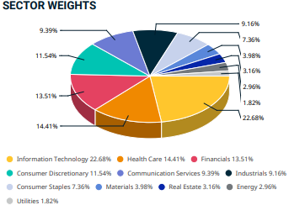
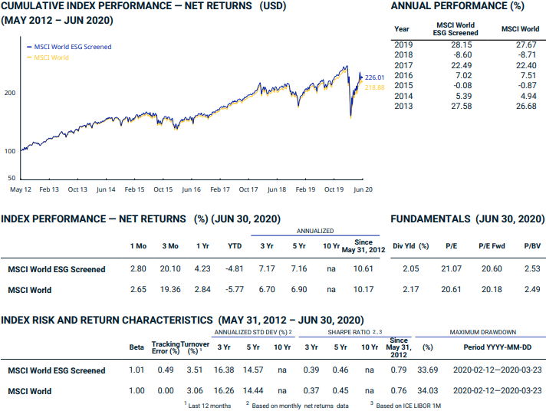
Derivatives on MSCI World ESG Screened Index
Source: MSCI

Slide 10
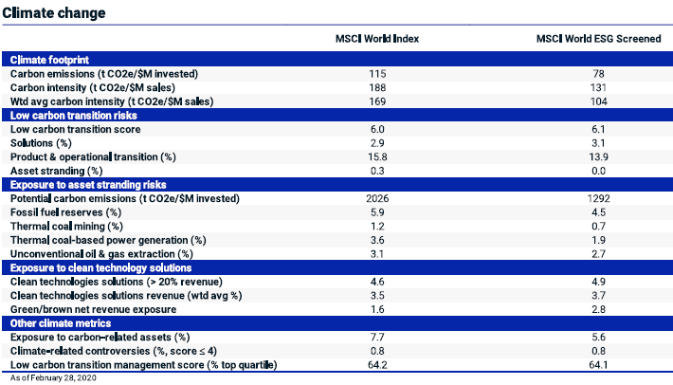
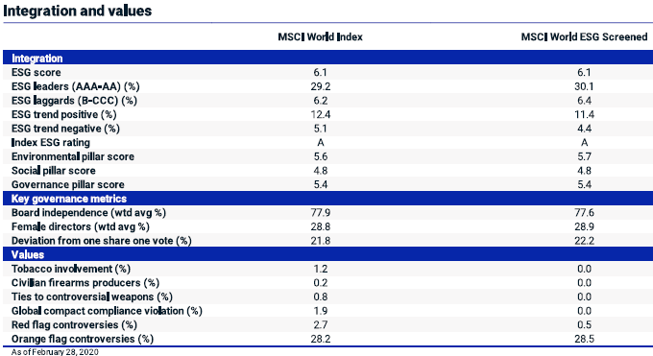
Derivatives on MSCI World ESG Screened Index
ESG Metrics

Slide 11
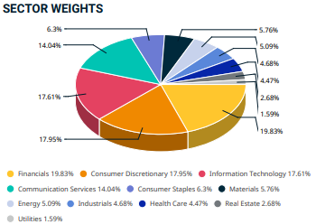
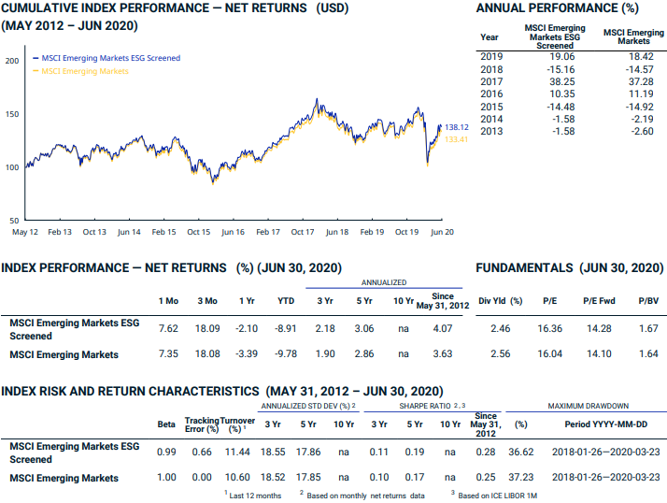
Derivatives on MSCI EM ESG Screened Index
Source: MSCI

Slide 12
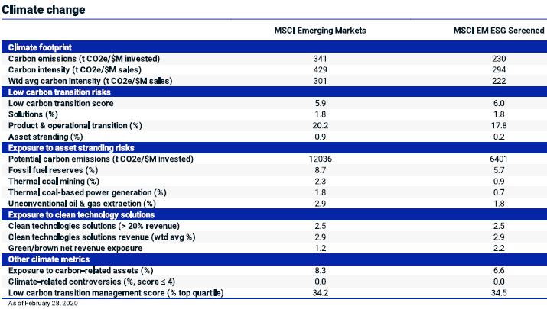
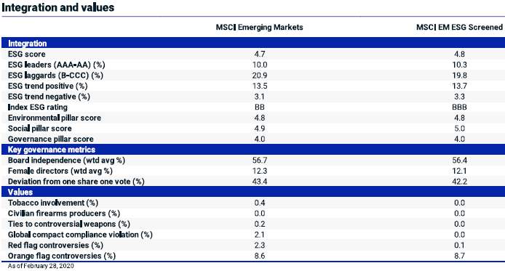
Derivatives on MSCI EM ESG Screened Index
ESG Metrics

Slide 13
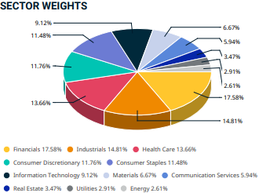
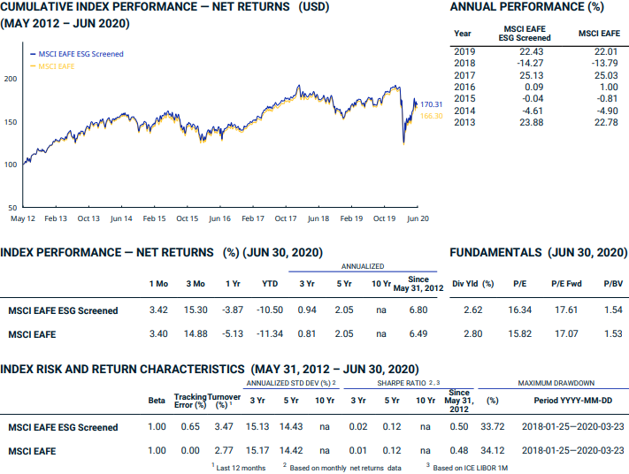
Derivatives on MSCI EAFE ESG Screened Index
Source: MSCI

Slide 14
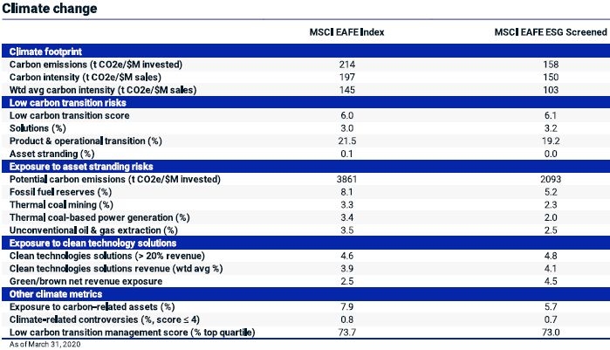
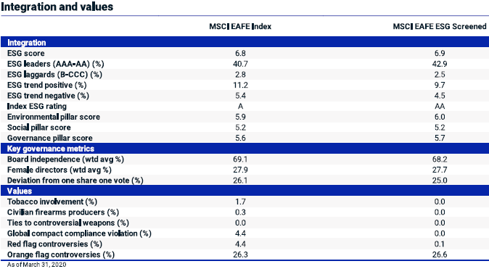
Derivatives on MSCI EAFE ESG Screened Index
ESG Metrics

Slide 15
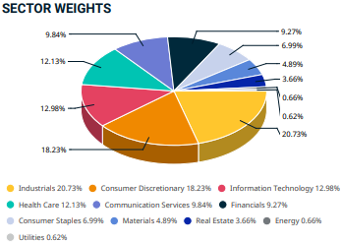
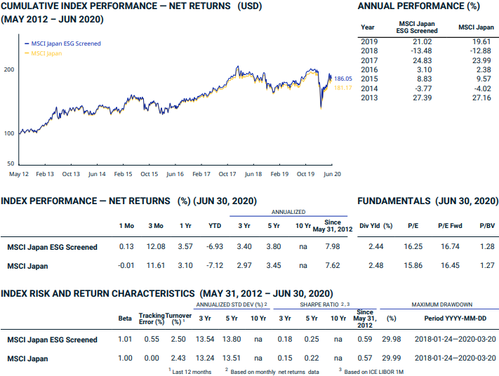
Derivatives on MSCI Japan ESG Screened Index
Source: MSCI

Slide 16
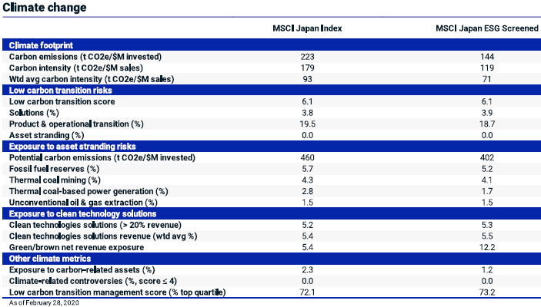
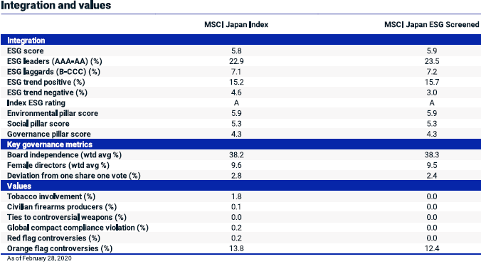
Derivatives on MSCI Japan ESG Screened Index
ESG Metrics

Slide 17
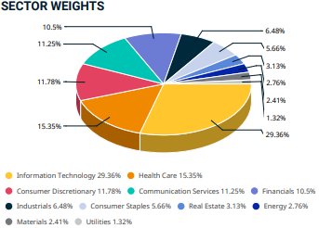
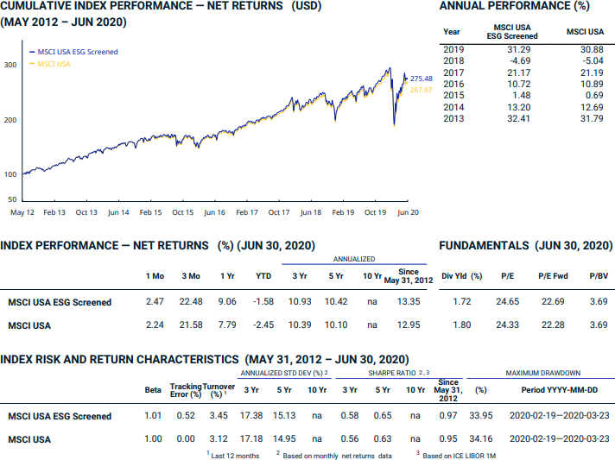
Derivatives on MSCI USA ESG Screened Index
Source: MSCI

Slide 18
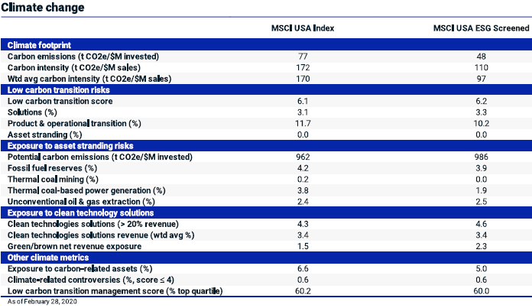
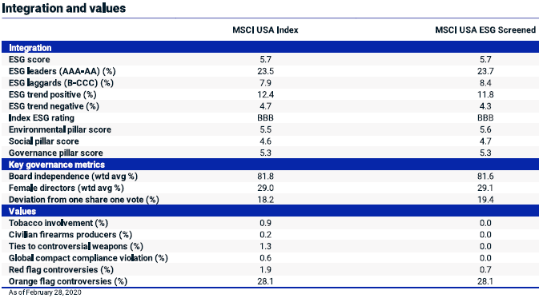
Derivatives on MSCI USA ESG Screened Index
ESG Metrics

Slide 19
Product Specifications
 |  | MSCI World ESG Screened futures | MSCI EM ESG Screened futures | MSCI EAFE ESG Screened futures | MSCI USA ESG Screened futures | MSCI Japan ESG Screened futures
EUREX Product Code |  | FMSW | FMSM | FMSF | FMSU | FMSJ
Index Type |  | USD/NTR | USD/NTR | USD/NTR | USD/NTR | USD/NTR
Bloomberg Product Code |  | HRLA | HRRA | HRWA | HRIA | HRYA
Contract Multiplier (USD) |  | USD 10 per Index point
Minimum Price Change |  | USD 0.5 index points
Minimum Block Trade Size |  | 100 | 50 | 50 | 100 | 50
Price Quotation |  | In points with two decimal places
Contract months/Maturities |  | Up to 36 months; quarterly months
Daily settlement price |  | Volume-weighted average during the last minute before 17:30 CET
Settlement |  | Cash settlement, payable on the first exchange day following the Final Settlement Day
Final settlement price |  | The final settlement price for MSCI ESG Screened derivatives is the index closing price on the last trading day.
Last Trading day |  | 3rd Friday of each expiration month if this is an exchange day; otherwise the exchange day immediately preceding that day. Close of trading in the maturing futures on the Last Trading Day is at 22:00 CET/CEST
Final Settlement day |  | The final settlement day is the trading day following the last trading day.
Trading Hours (CET) | Onbook | Pre-Trading Period: 01:00-01:10 CET; Continuous Trading: 01:10-22:00 CET; Post-Trading Period: 22:00-22:10 CET
 | Offbook | Trading Period: 01:15-22:00 CET; Post-Trading Period: 22:00-22:10 CET
Flexible contracts |  | Available
CFTC Approved |  | Yes
Underlying MSCI Factsheet |  | MSCI World ESG Screened | MSCI EM ESG Screened | MSCI EAFE ESG Screened | MSCI USA ESG Screened | MSCI Japan ESG Screened
Source: https://www.eurex.com/resource/blob/1736802/3c240e6ffa2235b577e2ea838e5d2209/data/Eurex_Circular_006_20_en_Attach1.pdf

Slide 20
Thank you!

Slide 21
Disclaimer
© Eurex 2020
Deutsche Börse AG (DBAG), Clearstream Banking AG (Clearstream), Eurex Frankfurt AG, Eurex Clearing AG (Eurex Clearing) and Eurex Repo GmbH (Eurex Repo) are corporate entities and are registered under German law. Eurex Global Derivatives AG is a corporate entity and is registered under Swiss law. Clearstream Banking S.A. is a corporate entity and is registered under Luxembourg law. Deutsche Boerse Asia Holding Pte. Ltd., Eurex Clearing Asia Pte. Ltd. and Eurex Exchange Asia Pte. Ltd are corporate entities and are registered under Singapore law. Eurex Frankfurt AG (Eurex) is the administrating and operating institution of Eurex Deutschland. Eurex Deutschland is in the following referred to as the “Eurex Exchange”.
All intellectual property, proprietary and other rights and interests in this publication and the subject matter hereof (other than certain trademarks and service marks listed below) are owned by DBAG and its affiliates and subsidiaries including, without limitation, all patent, registered design, copyright, trademark and service mark rights. While reasonable care has been taken in the preparation of this publication to provide details that are accurate and not misleading at the time of publication DBAG, Clearstream, Eurex, Eurex Clearing, Eurex Repo as well as the Eurex Exchange and their respective servants and agents (a) do not make any representations or warranties regarding the information contained herein, whether express or implied, including without limitation any implied warranty of merchantability or fitness for a particular purpose or any warranty with respect to the accuracy, correctness, quality, completeness or timeliness of such information, and (b) shall not be responsible or liable for any third party’s use of any information contained herein under any circumstances, including, without limitation, in connection with actual trading or otherwise or for any errors or omissions contained in this publication.
This publication is published for information purposes only and shall not constitute investment advice respectively does not constitute an offer, solicitation or recommendation to acquire or dispose of any investment or to engage in any other transaction. This publication is not intended for solicitation purposes but only for use as general information.
All descriptions, examples and calculations contained in this publication are for illustrative purposes only.
Eurex and Eurex Clearing offer services directly to members of the Eurex Exchange respectively to clearing members of Eurex Clearing. Those who desire to trade any products available on the Eurex market or who desire to offer and sell any such products to others or who desire to possess a clearing license of Eurex Clearing in order to participate in the clearing process provided by Eurex Clearing, should consider legal and regulatory requirements of those jurisdictions relevant to them, as well as the risks associated with such products, before doing so.
Only Eurex derivatives that are CFTC-approved may be traded via direct access in the United States or by United States persons. A complete, up-to-date list of Eurex derivatives that are CFTC-approved is available at: http://www.eurexchange.com/exchange-en/products/eurex-derivatives-us. In addition, Eurex representatives and participants may familiarise U.S. Qualified Institutional Buyers (QIBs) and broker-dealers with certain eligible Eurex
equity options and equity index options pursuant to the terms of the SEC’s July 1, 2013 Class No-Action Relief. A complete, up-to-date list of Eurex options that are eligible under the SEC Class No-Action Relief is available at: http://www.eurexchange.com/exchange-en/products/eurex-derivatives-us/eurex-options-in-the-us-for-eligible-customers... Lastly, U.S. QIBs and broker-dealers trading on behalf of QIBs may trade certain single-security futures and narrow-based security index futures subject to terms and conditions of the SEC’s Exchange Act Release No. 60,194 (June 30, 2009), 74 Fed. Reg. 32,200 (July 7, 2009) and the CFTC’s Division of Clearing and Intermediary Oversight Advisory Concerning the Offer and Sale of Foreign Security Futures Products to Customers Located in the United States (June 8, 2010).
Trademarks and Service Marks
Buxl®, DAX®, DivDAX®, eb.rexx®, Eurex®, Eurex Repo®, Eurex Strategy WizardSM, Euro GC Pooling®, FDAX®, FWB®, GC Pooling®,,GCPI®, MDAX®, ODAX®, SDAX®, TecDAX®, USD GC Pooling®, VDAX®, VDAX-NEW® and Xetra® are registered trademarks of DBAG. All MSCI indexes are service marks and the exclusive property of MSCI Barra. ATX®, ATX® five, CECE® and RDX® are registered trademarks of Vienna Stock Exchange AG. IPD® UK Quarterly Indexes are registered trademarks of Investment Property Databank Ltd. IPD and have been licensed for the use by Eurex for derivatives. SLI®, SMI® and SMIM® are registered trademarks of SIX Swiss Exchange AG. The STOXX® indexes, the data included therein and the trademarks used in the index names are the intellectual property of STOXX Limited and/or its licensors Eurex derivatives based on the STOXX® indexes are in no way sponsored, endorsed, sold or promoted by STOXX and its licensors and neither STOXX nor its licensors shall have any liability with respect thereto. Bloomberg Commodity IndexSM and any related sub-indexes are service marks of Bloomberg L.P. PCS® and Property Claim Services® are registered trademarks of ISO Services, Inc. Korea Exchange, KRX, KOSPI and KOSPI 200 are registered trademarks of Korea Exchange Inc. BSE and SENSEX are trademarks/service marks of Bombay Stock Exchange (BSE) and all rights accruing from the same, statutory or otherwise, wholly vest with BSE. Any violation of the above would constitute an offence under the laws of India and international treaties governing the same.
The names of other companies and third party products may be trademarks or service marks of their respective owners.
Eurex Deutschland qualifies as manufacturer of packaged retail and insurance-based investment products (PRIIPs) under Regulation (EU) No 1286/2014 on key information documents for packaged retail and insurance-based investment products (PRIIPs Regulation), and provides key information documents (KIDs) covering PRIIPs traded on Eurex Deutschland on its website under the following link: http://www.eurexchange.com/exchange-en/resources/regulations/eu-regulations/priips-kids.
In addition, according to Art. 14(1) PRIIPs Regulation the person advising on, or selling, a PRIIP shall provide the KID to retail investors free of charge.

