Slide 1
MSCI Derivatives at Eurex
October 2020

Slide 2
MSCI ESG derivatives complement Eurex’s MSCI Derivatives flows (1/2)
Eurex MSCI Derivatives are becoming an increasingly popular product
Evolution of Notional Volume and Notional Open Interest
Based on statistics from Jan 2020 – May 2020 Source: FIA

Slide 3
MSCI ESG derivatives complement Eurex’s MSCI Derivatives flows (2/2)
Eurex MSCI Derivatives are becoming an increasingly popular product
Open Interest for top MSCI Products
Eurex is | #1 | by Open Interest in MSCI Products (46% market share)
 |  | Traded volume YTD 2020: | 11,277,995 contracts
 |  | YoY Growth in MSCI Futures 2019 – 2020: | 13.32%
 | #3 | by Volume in MSCI Products (15% market share)
 |  | Open Interest in end June 2020: | 2.1 million contracts ~ EUR 81.9 billion
 |  | YoY Growth in MSCI Options 2019 – 2020: | 20.31%
Based on statistics from Jan 2020 – May 2020 Source: FIA
Open Interest as of June 30, 2020

Slide 4
Buy-Side Clients Flows have increased as more become aware of Eurex offering
Buy-side positions now represent almost 27% of Eurex’s MSCI derivatives flow
By the numbers:
Over 40 buy-side firms are already active on Eurex MSCI products
An additional 85 buy-side firms are waiting on side-lines for liquidity and OI to improve
Eurex has relationships with over 500 buy-side firms globally that will be leveraged
With UMR Rules coming into play over the next 2 years, we expect this flow to become stronger
    Conversations have already started with buy-side clients and dealers on how to optimize this shift
Partnerships with sell side in core regions and the expansion of Eurex buy-side outreach in Korea, China, Australia, Brazil, Mexico, Middle East – will fuel added flows
Growth in order book volumes will bring in more hedge funds globally

Slide 5
Growth drivers for Eurex MSCI derivatives
1. Lower margin rates
  Eurex’s Portfolio based margining methodology (PRISMA) offers the highest levels of cross-margin offsets across equity derivatives and capital efficiency
2. Wider breadth of offering
    MSCI Futures: Eurex offers futures over 117 regional and country indexes
    MSCI Options: Eurex offers options over 20 regional and country indexes
3. Improving order book liquidity picture
  Market makers provide streaming quotes in all 3 time zones and on calendar spreads during roll periods
4. Extended trading hours covering all time zones
  Asian hours trading has been crucial to compete and price in Emerging Markets
5. Building a MSCI Derivatives Ecosystem
    Derivatives on MSCI ESG Screened Indexes
    Futures on MSCI Dividend Point Indexes launched in Q4 2019
    Total Return Futures on MSCI USA to build on success of TRFs on SX5E

Slide 6
Agenda
1 | Growth drivers: Lower margin rates |  | 4 | Growth Drivers: Extended trading hours covering all time zones
2 | Growth Factors: Breadth of offering |  | 5 | Growth Drivers: Building an MSCI Ecosystem
3 | Growth Drivers: Improving order book liquidity picture

Slide 7
Growth drivers:
Lower margin rates
1

Slide 8
Growth drivers: Lower margin rates (1/2)
Eurex is one of the largest providers of Equity/Index derivatives, offering highest levels of capital efficiency
Name | Eurex | Notional (USD) | Long | Short | Initial margin (in EUR) | Total initial portfolio margin | Total initial portfolio margin | Margin savings
 |  |  |  |  |  | Without PRISMA (EUR) | With PRISMA (EUR)
MSCI World Futures | FMWN | 100,000,000 | 712 | 0 | 3,041,708.86 | 27,134,995.87 | 13,288,442.71 | 61.02%
DAX® Futures | FDAX | 10,000,000 | 337 | 0 | 17,244,793.44
EURO STOXX 50® Index Futures | FESX | 50,000,000 | 0 | 1,505 | 5,418,751.36
EURO STOXX® Banks Futures | FESB | 20,000,000 | 0 | 2,364 | 1,429,742.21
Margin rate per notional: 7.38%
*Calculation Date: 1 June 2020 **Near month Expiration: 19 June 2020

Slide 9
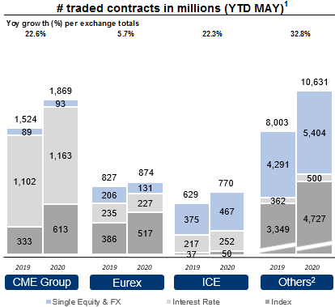
Growth drivers: Lower margin rates (2/2)
Eurex is one of the largest providers of Equity/Index derivatives, offering highest levels of capital efficiency
1) Including Interest Rate Derivatives (LTIR & STIR), Equity Index Derivatives,
Equity Derivatives and Foreign Exchange Derivatives
2) Other exchanges include: NSE, CBOE Holdings, Nasdaq OMX, BM&F Bovespa,
MOEX and others which are not considered as peer group

Slide 10
Eurex offers Futures on over 117 regional and country indexes (1/2)
Futures on MSCI Indexes
A | B | C |  | D | E | F | G | H | I | J | K | L | M | N | O | P | Q | R
Market | Eurex Code | Index Name | CFTC Approval | Currency | Index Type | Index Code | Future | Multiplier | Tick | Min. Block Size | % Off-Book (August) | % Agency Cleared Volume (August) | Notional Value per Contract (USD) | ADV 2020 | Volume (August) | Volume in EUR (August) | Open Interest as of August 31, 2020 | Open Interest in EUR as of August 31, 2020
EM | FMRS | MSCI Russia | N | USD | NTR | NDEUSRU Index | ZWBA | 50 | 0.1 | 10 | 0.0% | 35.9% | 64,846 | 411 | 149,834 | 8,137,503,748 | 360,581 | 19,324,328,576
DM & EM | FMSE | MSCI AC ASEAN | Y | USD | NTR | NDUESEA Index | UJCA | 10 | 1 | 1 | 0.0% | 0.0% | 36,618 | 4 | 133,534 | 4,095,261,825 | 224,820 | 6,993,001,100
DM | FMJP | MSCI JAPAN | Y | USD | NTR | NDDUJN Index | FMIA | 10 | 1 | 50 | 0.0% | 50.0% | 66,513 | 2,245 | 24,393 | 1,358,846,213 | 90,228 | 5,046,270,553
DM | FMOV | MSCI World Value | Y | USD | NTR | NDUVWI Index | FMOA | 10 | 1 | 1 | 100.0% | 27.4% | 71,530 | 28 | 46,572 | 2,790,032,703 | 80,326 | 4,885,922,940
DM | FMGC | MSCI Canada | Y | USD | GTR | GDDUCA Index | ZTBA | 10 | 1 | 5 | 0.0% | 0.0% | 78,881 | 1,556 | 69,648 | 4,601,252,594 | 62,343 | 4,146,674,129
DM | FMED | MSCI Europe | Y | USD | NTR | NDDUE15 Index | FJLA | 10 | 1 | 50 | 0.0% | 0.0% | 68,422 | 1,853 | 6,131 | 351,336,184 | 68,758 | 3,885,572,069
EM | FMPH | MSCI Philippines | N | USD | NTR | NDEUPHF Index | ZVWA | 50 | 0.1 | 10 | 90.0% | 43.1% | 53,273 | 51 | 3,450 | 153,929,907 | 81,586 | 3,607,388,978

Slide 11
Eurex offers Futures on over 117 regional and country indexes (2/2)
Futures on MSCI Indexes
A | B | C |  | D | E | F | G | H | I | J | K | L | M | N | O | P | Q | R
Market | Eurex Code | Index Name | CFTC Approval | Currency | Index Type | Index Code | Future | Multiplier | Tick | Min. Block Size | % Off-Book (August) | % Agency Cleared Volume (August) | Notional Value per Contract (USD) | ADV 2020 | Volume (August) | Volume in EUR (August) | Open Interest as of August 31, 2020 | Open Interest in EUR as of August 31, 2020
DM | FMEU | MSCI Europe | Y | EUR | NTR | MSDEE15N Index | ZRPA | 100 | 0.05 | 250 | 100.0% | 50.0% | 25,852 | 8,817 | 52,958 | 1,146,606,580 | 154,392 | 3,325,592,655
DM | FMFP | MSCI EAFE | Y | USD | Price | MSDUEAFE Index | FFPA | 50 | 0.1 | 10 | 0.0% | 0.0% | 95,318 | 352 | 2,903 | 231,749,086 | 28,943 | 2,271,325,879
DM | FMGS | MSCI USA | Y | USD | GTR | GDDUUS Index | JHTA | 10 | 1 | 1 | 0.0% | 0.0% | 147,427 | 199 | 5,065 | 625,391,422 | 16,623 | 2,115,366,725
DM | FMWD | MSCI World Cons. Discret. | Y | USD | NTR | NDWUCDIS Index | HKTA | 100 | 0.1 | 1 | 100.0% | 50.0% | 147,427 | - | 5,065 | 625,391,422 | 16,623 | 2,115,366,725
EM | FMQA | MSCI Qatar | N | USD | NTR | MGCUQAN Index | ZRDA | 10 | 0.5 | 10 | 88.1% | 20.0% | 49,751 | 121 | 5,051 | 210,462,260 | 27,072 | 1,117,261,440
EM | FMEE | MSCI Emerging Markets EMEA | Y | USD | NTR | NDDUEMEA Index | ZTYA | 100 | 0.1 | 50 | 100.0% | 50.0% | 54,830 | 2,040 | 21,223 | 974,584,557 | 24,457 | 1,114,971,516
DM & EM | FMAA | MSCI AC Asia | Y | USD | NTR | NDAUACA Index | UJBA | 100 | 0.1 | 10 | 0.0% | 0.0% | 24,113 | 24 | 12,294 | 248,274,075 | 53,461 | 1,090,078,945
EM | FMSA | MSCI Saudi Arabia | Y | USD | NTR | M1SAP Index | HSYA | 10 | 0.5 | 25 | 100.0% | 50.0% | 28,824 | 1,363 | 6,251 | 150,903,947 | 41,831 | 991,824,648

Slide 12
Growth Factors: Breadth of offering
2

Slide 13
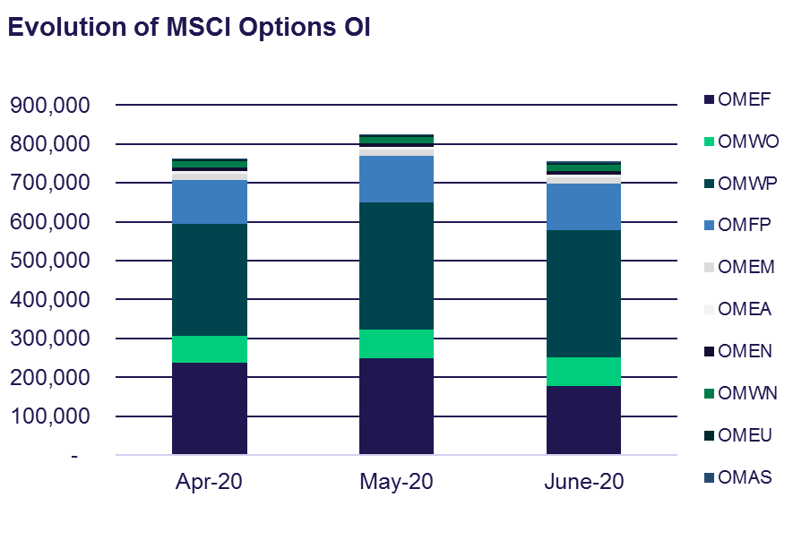
Growth Factors: Breadth of offering (1/2)
MSCI Options have grown by over 45% in open interest YoY
Offering F&O on one platform offers advantages in hedging, margining, strategy trading
Focus is on EM, World & EAFE indices, whereby (in opposite to MSCI Futures) the main interest is on price indices
29 bn EUR are currently invested in 10 different options
Market Making Quotation (on-screen) is still fairly thin

Slide 14
Growth Factors: Breadth of offering (2/2)
MSCI Options have grown by over 45% in open interest YoY

Slide 15
Growth Drivers: Improving order book liquidity picture
3

Slide 16
Growth Drivers: Improving order book liquidity picture
In other contracts (like MSCI EM) order book liquidity has continuously improved since 2015
ELM in FMEM and FMEF for a 1M EUR order
Order book volumes in MSCI EM (NTR, USD & EUR)
Spreads on MSCI EM Futures, for both the NTR index (FMEM) as well as for Price index (FMEF), are tightening
Average impact for a 1M EUR order in EM has decreased from ~ 9 bps in Q1, 2018 to ~7 bps in Q1, 2019
Orderbook volumes have increased on average 5% month-over-month for both FMEN and FMEM for the past year.
Algo firm participation, which is usually a function of ADV, is expected to increase further.
16

Slide 17
Growth Drivers: Extended trading hours covering all time zones
4

Slide 18
Growth Drivers: Extended trading hours covering all time zones
Asian hours have been crucial to compete and price in Emerging Markets
Share of MSCI EM index that is open for trading
Eurex extended trading hours

Slide 19
Growth Drivers: Building an MSCI Ecosystem
5

Slide 20
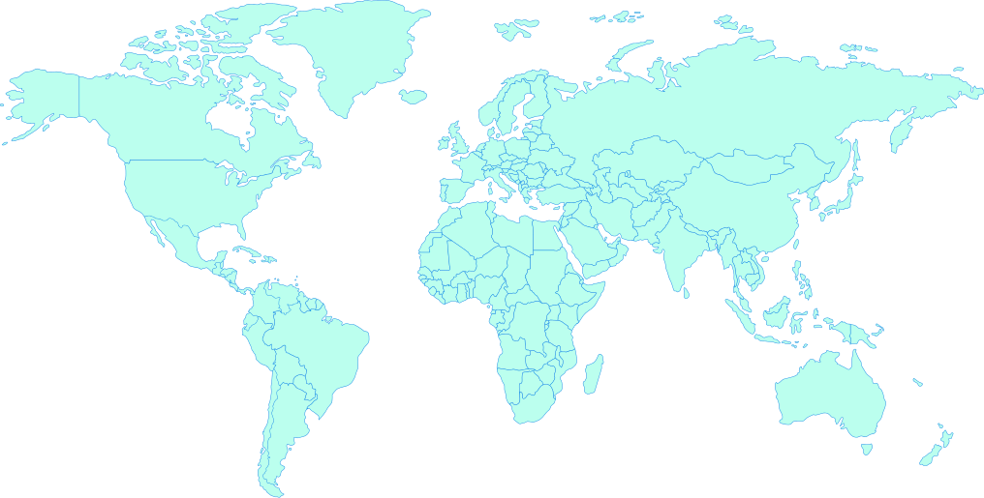
Growth Drivers: Building an MSCI Ecosystem
Futures on MSCI ESG Screened Indexes were launched on March 2, 2020
MSCI
USA ESG
Screened
MSCI
EAFE ESG
Screened
MSCI
Japan ESG
Screened
MSCI
World ESG
Screened
MSCI
EM ESG
Screened
This Photo by Unknown Author is licensed under CC BY-SA

Slide 21
MSCI ESG Screened Indexes are closest to benchmark (1/2)
Easy access to ESG compliance without compromising performance
Product Value
  Flexible solution for asset managers with strict mandates to achieve ESG compliance
  Based on liquid and successful benchmark indices
  Similar risk and return figures compared to related benchmarks
  Simple and fast integration of the ESG Futures into the existing trading infrastructure
  Portfolio risk based margin (PRISMA) enables margin offsets
  Eurex ESG futures will lower carbon footprint
  Cost Efficient to incorporate ESG into investment strategies and manage undesired sustainability risks
General Facts
  For the entire ESG offering, the index investment families are covering negative/exclusionary screening, norms-based screening, positive/best-in-class screening and sustainability themed investing
  Stepwise extension to complementary sustainability offerings, further regions and options
  Exclusions can help clients align their portfolios with: Social values; Financial, risk mitigation objectives; Regulations, global norms and treaties
ESG Screened
Easy to Implement
Easy to Access
Key Values

Slide 22
MSCI ESG Screened Indexes are closest to benchmark (2/2)
Easy access to ESG compliance without compromising performance
Why choose MSCI ESG Screened Indexes?
Aims to represent a broad universe of securities with limited exclusions
Provides investors
with a transparent, consistent and more efficient option for those seeking to implement exclusions
The MSCI Screened Index leverages MSCI’s award-winning ESG Research expertise
The MSCI Screened Index can be used as a benchmark or as a basis for financial products
A market cap index with limited exclusions historically resulting in a minimal tracking error

Slide 23
Exclusion Criteria for MSCI ESG Screened Indexes
Selection of exclusion
ESG - Exclusion criteria
E | S | G
Thermal Coal: Companies deriving 5% or more revenue from mining or thermal coal or 5% or more revenue from thermal coal based power generation | Tobacco: Companies classified as producers or deriving 5% or more aggregate revenue from production, distribution, retail and supply of tobacco-related products | UN Global Compact: Companies that are not in compliance with the United Nations Global Compact principles
Oil Sands: Companies deriving 5% or more revenue from oil sands extraction | Controversial weapons: Companies with ties to cluster bombs, landmines, depleted uranium weapons, chemical and biological weapons, blinding laser weapons, non-detectable fragments, incendiary weapons
 | Civilian Firearms: Companies classified as producers of firearms and small arms ammunition for civilian market or deriving 5% or more revenue from distribution of firearms and small arms
 | Nuclear Weapons: Companies connect with nuclear weapons: Manufacturers, providers of components or auxiliary services related to nuclear warheads and missiles; Assemblers of delivery platforms for nuclear weapons

Slide 24
Product Specifications (1/2)
 | MSCI World ESG Screened futures | MSCI EM ESG Screened futures | MSCI EAFE ESG Screened futures | MSCI USA ESG Screened futures | MSCI Japan ESG Screened futures
EUREX Product Code | FMSW | FMSM | FMSF | FMSU | FMSJ
Index Type | USD/NTR | USD/NTR | USD/NTR | USD/NTR | USD/NTR
Bloomberg Product Code | HRLA | HRRA | HRWA | HRIA | HRYA
Contract Multiplier (USD) | USD 10 per Index point
Minimum Price Change | USD 0.5 index points
Minimum Block Trade Size | 100 | 50 | 50 | 100 | 50
Price Quotation | In points with two decimal places
Contract months/Maturities | Up to 36 months; quarterly months
Source: https://www.eurexchange.com/resource/blob/1736802/3c240e6ffa2235b577e2ea838e5d2209/data/Eurex_Circular_006_20_en_Attach1.pdf

Slide 25
Product Specifications (2/2)
 |  | MSCI World ESG Screened futures | MSCI EM ESG Screened futures | MSCI EAFE ESG Screened futures | MSCI USA ESG Screened futures | MSCI Japan ESG Screened futures
Daily settlement price |  | Volume-weighted average during the last minute before 17:30 CET
Settlement |  | Cash settlement, payable on the first exchange day following the Final Settlement Day
Final settlement price |  | The final settlement price for MSCI ESG Screened derivatives is the index closing price on the last trading day.
Last Trading day |  | 3rd Friday of each expiration month if this is an exchange day; otherwise the exchange day immediately preceding that day. Close of trading in the maturing futures on the Last Trading Day is at 22:00 CET/CEST
Final Settlement day |  | The final settlement day is the trading day following the last trading day.
Trading Hours (CET) | Onbook | Pre-Trading Period: 01:00-01:10 CET; Continuous Trading: 01:10-22:00 CET; Post-Trading Period: 22:00-22:10 CET
 | Offbook | Trading Period: 01:15-22:00 CET; Post-Trading Period: 22:00-22:10 CET
Flexible contracts |  | Available
CFTC Approved |  | Yes
Underlying MSCI Factsheet |  | MSCI World ESG Screened | MSCI EM ESG Screened | MSCI EAFE ESG Screened | MSCI USA ESG Screened | MSCI Japan ESG Screened
Source: https://www.eurexchange.com/resource/blob/1736802/3c240e6ffa2235b577e2ea838e5d2209/data/Eurex_Circular_006_20_en_Attach1.pdf

Slide 26
Growth Drivers: Building an MSCI Ecosystem
Futures on MSCI Dividend Point Indexes launched in Q4 2019
Primary users, trade rationale and benefits
 | Institutions | Hedge funds | Dealers
Trade rationale | Beta Replacement Benchmarking Bond Proxy | Tactical Positioning Hedging | Hedging
Benefits | Wider array of tools to implement outlook Trade the actual projected improvements in earnings and payout ratios of companies Less volatility more correlation to corporate earnings growth Minimise tracking error Provide broad and diversified coverage of names | Tighter spreads Increased liquidity Ability to implement views in a relative value manner to other asset classes/ term structure Ease of calculating and trading valuation discounts versus perceived fair value | Additional tools to better hedge risks in structured product space and one delta positions Single currency denomination and consistent corporate action treatment
The dividends included would be the ordinary, unadjusted, gross cash or cash equivalent dividends declared and paid on the individual equity components of the respective index in the contracts specified period. The excluded items will be those which are described or determined as special dividends, extraordinary dividends and return of capital payments etc. as determined under the MSCI Rulebook
The treatment of Japanese and Korean dividends is described in detail in the MSCI Index calculation methodology. As per the methodology, estimated dividends are used for Japanese and Korean securities where available and adjustments are made later

Slide 27
Growth Drivers: Building an MSCI Ecosystem (1/2)
Futures on MSCI Dividend Point Indexes launched in Q4 2019
Dividend futures
Underlying indexes | MSCI EAFE MSCI World (FFPD, FWPD) | MSCI Emerging Markets (FEFD)
Contract multiplier | USD 100 per index point | USD 500 per index point
Price quotation | In index points with one decimal | In index points with two decimal
Minimum price change | 0.1 index points, i.e. USD 10 | 0.01 index points, i.e. USD 5
Contract months | 5 years; Five nearest successive annual contracts of December cycle
Settlement | Cash settlement, payable on the first exchange day following the final settlement day

Slide 28
Growth Drivers: Building an MSCI Ecosystem (2/2)
Futures on MSCI Dividend Point Indexes launched in Q4 2019
Dividend futures
Daily settlement | Determined from the volume-weighted average of the prices of all transactions during the last minute before 17:30 CET, provided that at least 5 trades have been transacted in that period
Last trading day/ close of trading | Last trading day is 3rd Friday of December cycle if this is an exchange day is at Eurex; otherwise exchange day it is immediately preceding that day Close of trading day is 22:00 CET
Final settlement day | It is the exchange day immediately following the last trading day
Contract period | For purposes of dividends declared and paid, contract period will be from but excluding the 3rd Friday of December preceding the maturity month, if this is an exchange day; up to and including the exchange day immediately preceding that day
Final settlement price | Calculation of final settle price is based upon final value of underlying MSCI Index dividends as calculated by MSCI for that contract period Summation of unadjusted ordinary dividends declared and paid in the contract period on the individual constituents of the index and calculated in terms of index points Gross ordinary dividends per share are the unadjusted cash dividends declared and paid on that individual equity constituent of the index. This amount excludes special dividends, extraordinary dividends and return of capital payments etc. as determined under the MSCI rulebook
Trading hours | Order book: 08:30-22:00 CET Off-book: 08:30-22:00 CET

Slide 29
Growth Drivers: Building an MSCI Ecosystem (1/2)
Total return futures on MSCI USA to build on success of TRFs on SX5E
Traded Volume YTD 2020:
6,184,363 contracts ~ EUR 212.9 Billion
Growth in Volume 2018 - 2019
115%
Open Interest in end June 2020
1.9 million contracts ~ EUR 72 billion
Growth in Open Interest June 2020 – June 2019
98%

Slide 30
Growth Drivers: Building an MSCI Ecosystem (2/2)
Total return futures on MSCI USA to build on success of TRFs on SX5E
Open Interest per maturity

Slide 31
MSCI Derivatives fee structure
Product Group | MSCI Futures and Options |  |  |  |  |  | Derivatives on MSCI ESG Screened Index |  |  | MSCI Dividend Derivatives
Contract | MSCI Futures |  |  | MSCI Options |  |  | Derivatives on MSCI ESG Screened Index |  |  | MSCI EM Index Dividend Futures |  |  | MSCI EAFE Index Dividend Futures MSCI World Index Dividend Futures
Currency | EUR/ GBP/ USD |  |  | EUR/ GBP/ USD |  |  | USD |  |  | USD |  |  | USD
Account | A | P | M | A | P | M | A | P | M | A | P | M | A | P | M
Order book * | 0.5 | 0.5 | 0.5 | 0.54 | 0.5 | 0.5 | 0.5 | 0.5 | 0.5 | 2 | 1.8 | 1.8 | 1.4 | 1.2 | 1.2
Eurex Enlight * | 0.75 | 0.75 | 0.75 | 0.56 | 0.5 | 0.5 | 0.75 | 0.75 | 0.75 | 3 | 2.7 | 2.7 | 2.1 | 1.8 | 1.8
TES * | 0.75 | 0.75 | 0.75 | 0.58 | 0.5
Threshold (number of contracts) | n. a. | n. a. | n. a. | 3,000 | 2,000 | n. a. | n. a. | n. a. | n. a. | n. a. | n. a. | n. a. | n. a. | n. a. | n. a.
Standard fee per contract (contract number ≤ threshold value) in respective currencies

Slide 32
Thank you!

Slide 33
Disclaimer
© Eurex 2020
Deutsche Börse AG (DBAG), Clearstream Banking AG (Clearstream), Eurex Frankfurt AG, Eurex Clearing AG (Eurex Clearing) and Eurex Repo GmbH (Eurex Repo) are corporate entities and are registered under German law. Eurex Global Derivatives AG is a corporate entity and is registered under Swiss law. Clearstream Banking S.A. is a corporate entity and is registered under Luxembourg law. Deutsche Boerse Asia Holding Pte. Ltd., Eurex Clearing Asia Pte. Ltd. and Eurex Exchange Asia Pte. Ltd are corporate entities and are registered under Singapore law. Eurex Frankfurt AG (Eurex) is the administrating and operating institution of Eurex Deutschland. Eurex Deutschland is in the following referred to as the “Eurex Exchange”.
All intellectual property, proprietary and other rights and interests in this publication and the subject matter hereof (other than certain trademarks and service marks listed below) are owned by DBAG and its affiliates and subsidiaries including, without limitation, all patent, registered design, copyright, trademark and service mark rights. While reasonable care has been taken in the preparation of this publication to provide details that are accurate and not misleading at the time of publication DBAG, Clearstream, Eurex, Eurex Clearing, Eurex Repo as well as the Eurex Exchange and their respective servants and agents (a) do not make any representations or warranties regarding the information contained herein, whether express or implied, including without limitation any implied warranty of merchantability or fitness for a particular purpose or any warranty with respect to the accuracy, correctness, quality, completeness or timeliness of such information, and (b) shall not be responsible or liable for any third party’s use of any information contained herein under any circumstances, including, without limitation, in connection with actual trading or otherwise or for any errors or omissions contained in this publication.
This publication is published for information purposes only and shall not constitute investment advice respectively does not constitute an offer, solicitation or recommendation to acquire or dispose of any investment or to engage in any other transaction. This publication is not intended for solicitation purposes but only for use as general information.
All descriptions, examples and calculations contained in this publication are for illustrative purposes only.
Eurex and Eurex Clearing offer services directly to members of the Eurex Exchange respectively to clearing members of Eurex Clearing. Those who desire to trade any products available on the Eurex market or who desire to offer and sell any such products to others or who desire to possess a clearing license of Eurex Clearing in order to participate in the clearing process provided by Eurex Clearing, should consider legal and regulatory requirements of those jurisdictions relevant to them, as well as the risks associated with such products, before doing so.
Only Eurex derivatives that are CFTC-approved may be traded via direct access in the United States or by United States persons. A complete, up-to-date list of Eurex derivatives that are CFTC-approved is available at: http://www.eurexchange.com/exchange-en/products/eurex-derivatives-us. In addition, Eurex representatives and participants may familiarise U.S. Qualified Institutional Buyers (QIBs) and broker-dealers with certain eligible Eurex
equity options and equity index options pursuant to the terms of the SEC’s July 1, 2013 Class No-Action Relief. A complete, up-to-date list of Eurex options that are eligible under the SEC Class No-Action Relief is available at: http://www.eurexchange.com/exchange-en/products/eurex-derivatives-us/eurex-options-in-the-us-for-eligible-customers... Lastly, U.S. QIBs and broker-dealers trading on behalf of QIBs may trade certain single-security futures and narrow-based security index futures subject to terms and conditions of the SEC’s Exchange Act Release No. 60,194 (June 30, 2009), 74 Fed. Reg. 32,200 (July 7, 2009) and the CFTC’s Division of Clearing and Intermediary Oversight Advisory Concerning the Offer and Sale of Foreign Security Futures Products to Customers Located in the United States (June 8, 2010).
Trademarks and Service Marks
Buxl®, DAX®, DivDAX®, eb.rexx®, Eurex®, Eurex Repo®, Eurex Strategy WizardSM, Euro GC Pooling®, FDAX®, FWB®, GC Pooling®,,GCPI®, MDAX®, ODAX®, SDAX®, TecDAX®, USD GC Pooling®, VDAX®, VDAX-NEW® and Xetra® are registered trademarks of DBAG. All MSCI indexes are service marks and the exclusive property of MSCI Barra. ATX®, ATX® five, CECE® and RDX® are registered trademarks of Vienna Stock Exchange AG. IPD® UK Quarterly Indexes are registered trademarks of Investment Property Databank Ltd. IPD and have been licensed for the use by Eurex for derivatives. SLI®, SMI® and SMIM® are registered trademarks of SIX Swiss Exchange AG. The STOXX® indexes, the data included therein and the trademarks used in the index names are the intellectual property of STOXX Limited and/or its licensors Eurex derivatives based on the STOXX® indexes are in no way sponsored, endorsed, sold or promoted by STOXX and its licensors and neither STOXX nor its licensors shall have any liability with respect thereto. Bloomberg Commodity IndexSM and any related sub-indexes are service marks of Bloomberg L.P. PCS® and Property Claim Services® are registered trademarks of ISO Services, Inc. Korea Exchange, KRX, KOSPI and KOSPI 200 are registered trademarks of Korea Exchange Inc. BSE and SENSEX are trademarks/service marks of Bombay Stock Exchange (BSE) and all rights accruing from the same, statutory or otherwise, wholly vest with BSE. Any violation of the above would constitute an offence under the laws of India and international treaties governing the same.
The names of other companies and third party products may be trademarks or service marks of their respective owners.
Eurex Deutschland qualifies as manufacturer of packaged retail and insurance-based investment products (PRIIPs) under Regulation (EU) No 1286/2014 on key information documents for packaged retail and insurance-based investment products (PRIIPs Regulation), and provides key information documents (KIDs) covering PRIIPs traded on Eurex Deutschland on its website under the following link: http://www.eurexchange.com/exchange-en/resources/regulations/eu-regulations/priips-kids.
In addition, according to Art. 14(1) PRIIPs Regulation the person advising on, or selling, a PRIIP shall provide the KID to retail investors free of charge.

